Slide 1
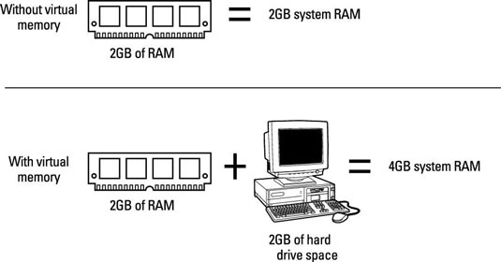
CSEN3103 – Sec A- Virtual Memory(by NB)

Slide 2
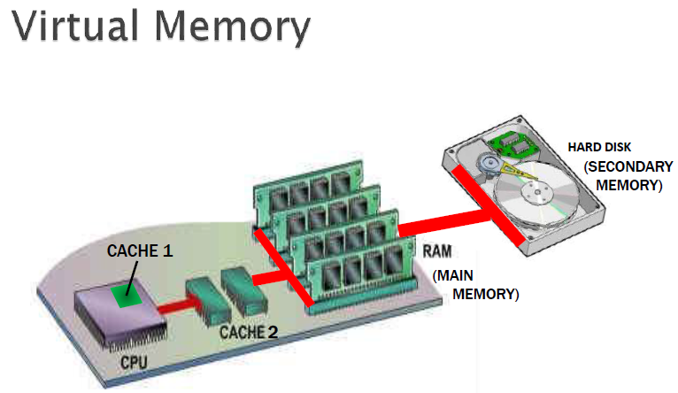
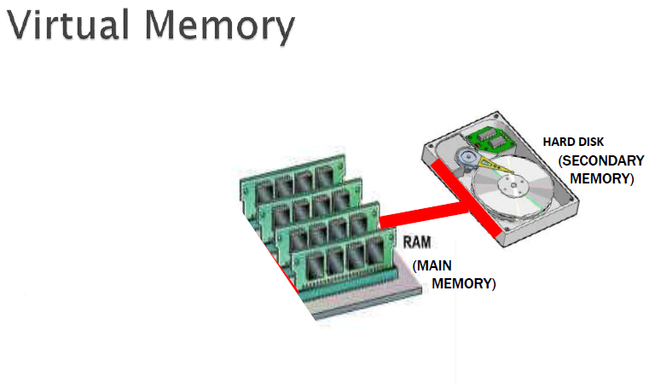
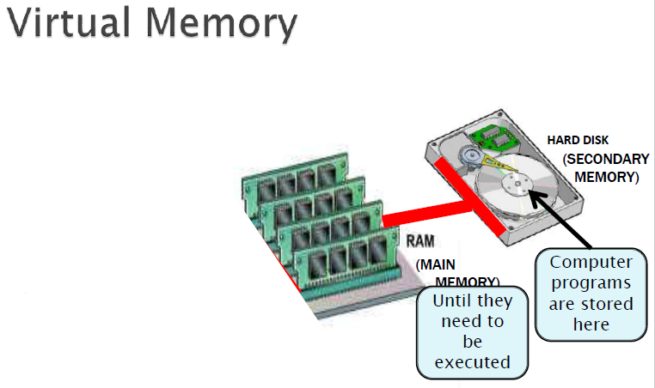
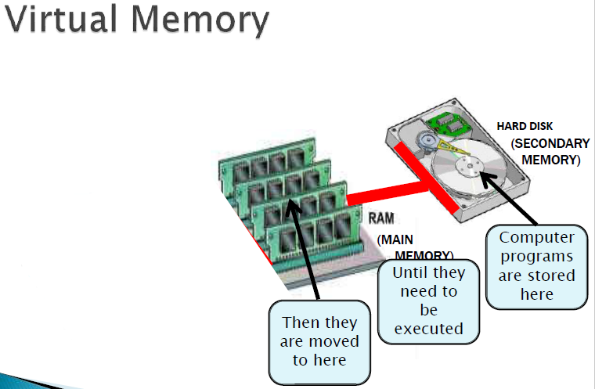

Slide 3
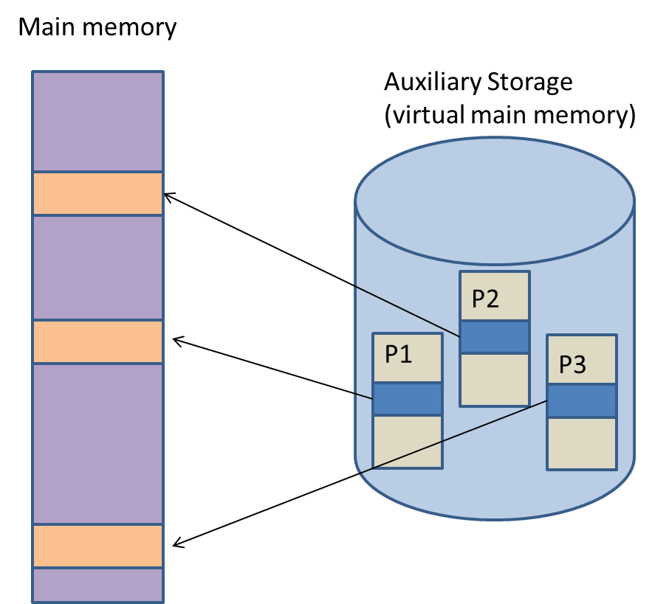
Virtual Memory
Main memory and auxiliary storage have been logically combined by the OS to give the illusion that a main memory of extremely large size is available with the system.
Active portions of processes P1, P2 and P3 loaded into main memory

Slide 4

Virtual Memory
The ability to execute a program that is only partially in memory has the following advantages:
A program would no longer be constrained by the amount of physical memory that is available.
Users would be able to write programs for an extremely large virtual address space, simplifying the programming task.
Because each user program could take less physical memory, more programs could be run at the same time, with a corresponding increase in CPU utilization and throughput but with no increase in response time or turnaround time.
[Turnaround time is the interval between the submission of a job and its completion.
Response time is the interval between submission of a request, and the first response to that request.]

Slide 5
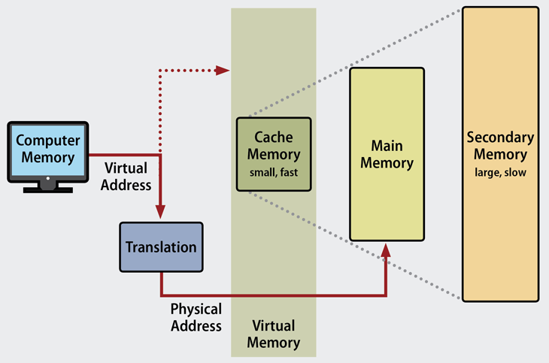

Slide 6
Virtual memory – separation of user logical memory from physical memory
Only part of the program needs to be in memory for execution
Logical address space can therefore be much larger than physical address space
Allows address spaces to be shared by several processes
Allows for more efficient process creation
More programs running concurrently
Less I/O needed to load or swap processes
Virtual memory can be implemented via:
  Demand paging
  Demand segmentation

Slide 7
Demand Paging
The virtual memory manager brings the pages of a process into main memory as and when demanded by the process.
The virtual memory manager maintains the following data structures to manage the virtual memory:
  Page
  Page frame
  Free page frame list
  Dirty page frame list
  Page table
  Working set
  Swap area

Slide 8
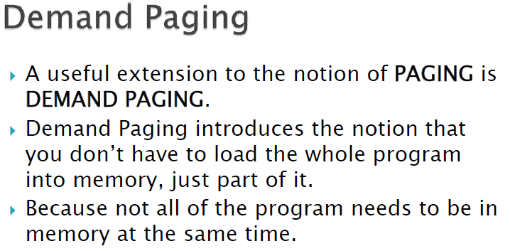
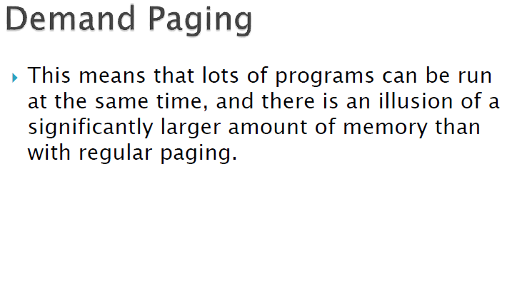
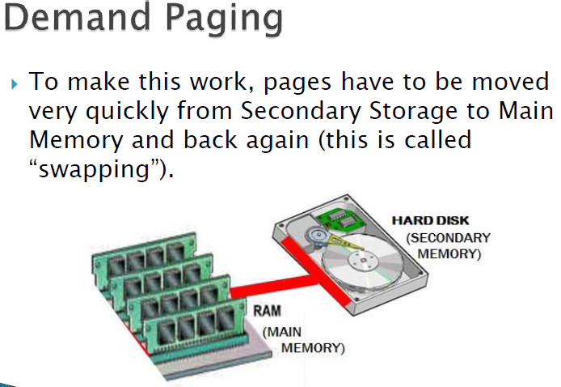

Slide 9
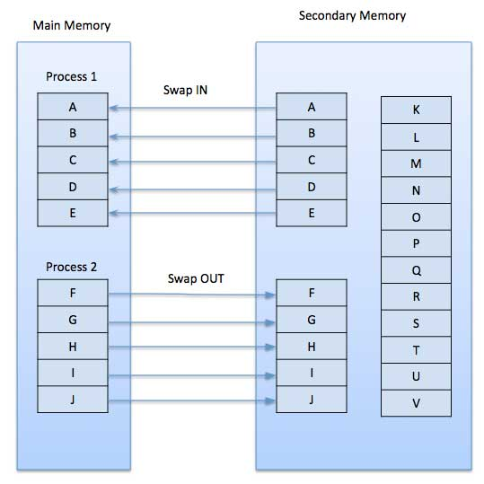

Slide 10
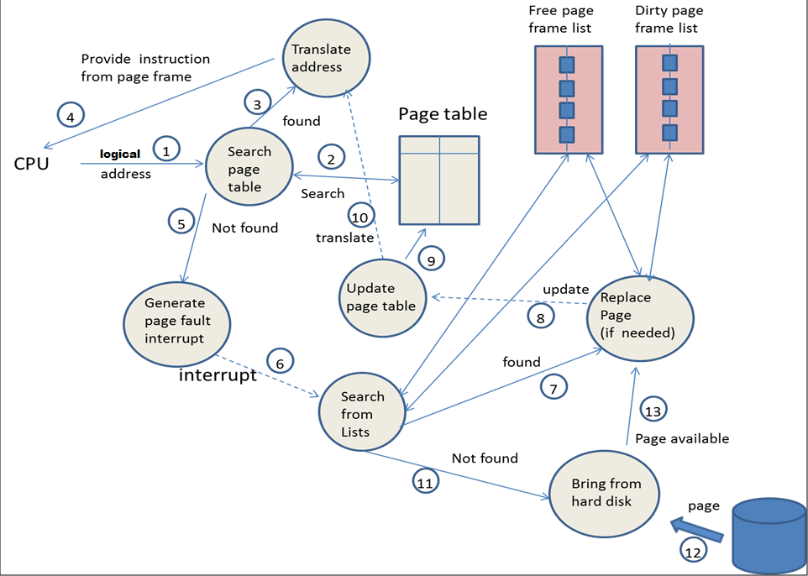
Virtual Memory System

Slide 11
Virtual Address Space
The virtual address space of a process refers to the logical (or virtual) view of how a process is stored in memory.
In this view, a process begins at a certain logical address – say, address 0 – and exists in contiguous memory space.
The physical memory may be organized in page frames and that the physical page frames assigned to a process may not be contiguous.
It is up to the memory management unit (MMU) to map logical pages to physical page frames in memory.
We allow the heap to grow upward in memory as it is used for dynamic memory allocation.
Similarly, we allow for the stack to grow downward in memory through successive function calls.

Slide 12
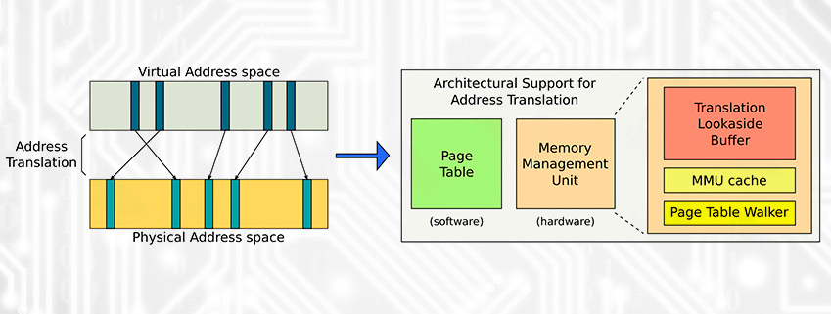


Slide 13
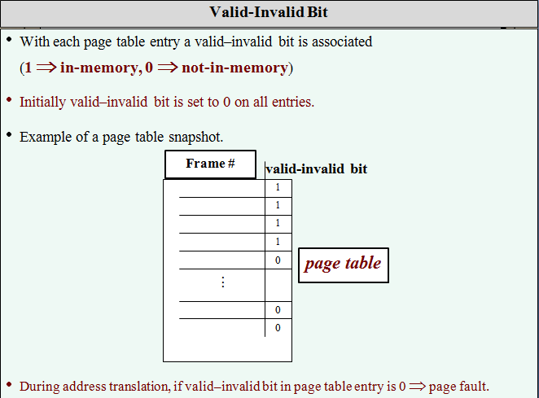

Slide 14
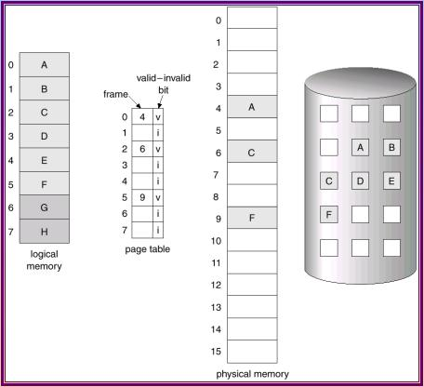

Slide 15
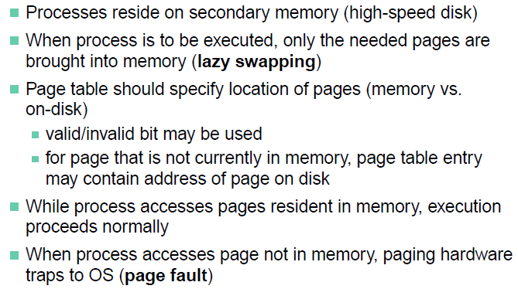
Demand Paging
CESN3103-Virtual Memory

Slide 16
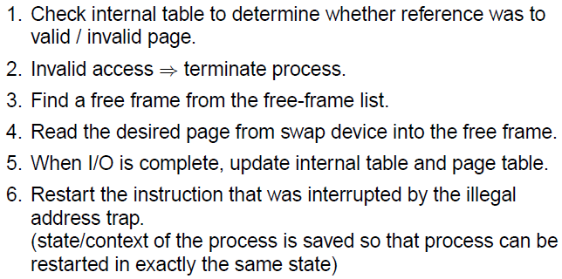
Page Fault
CESN3103-Virtual Memory

Slide 17
Page Replacement
Prevent over-allocation of memory by modifying page-fault service routine to include page replacement.
Use modify (dirty) bit to reduce overhead of page transfers – only modified pages are written to disk.
Page replacement completes separation between logical memory and physical memory – large virtual memory can be provided on a smaller physical memory.
CESN3103-Virtual Memory

Slide 18
Active Page Replacement Policies
FIFO: Utilizing queue data structure, replaces the first VM page that got accepted/included in MM for program execution.
Optimal Page Replacement Policy: This policy is based on the premise: replace the page which will not be used for the longest period of time.
Optimal Page Replacement Policy: According to Belady (1966), at a page fault, replace the page whose next reference is farthest in the page reference string. This policy’s drawback in practical scenario :- Infeasible because VM handler does not have knowledge of the future behavior of a process.
CESN3103-Virtual Memory

Slide 19
Active Page Replacement Policies
LRU Page Replacement: In this policy, the least recently page is surrendered by the system.
Uses the principle of locality of reference (once a page is referred, it may be referred in near future). At every page fault, the least recently used page is replaced by a new page.
The page table entry (PT) of a page records the time when the page was last referenced. This piece of information is initialized when the VM page is loaded in VM system and is modified every time the same page is referenced.
CESN3103-Virtual Memory

Slide 20
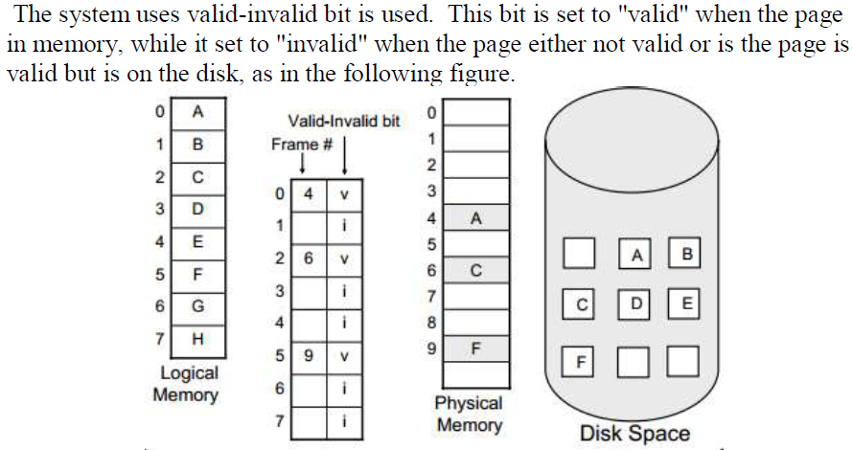
CESN3103-Virtual Memory

Slide 21
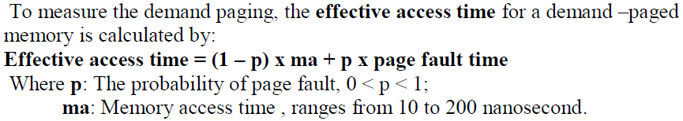
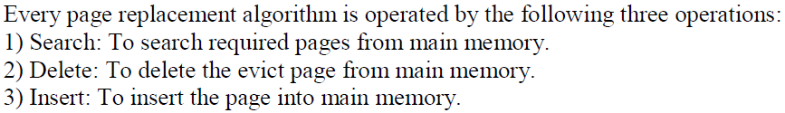
Delete: Swap – out equivalent to evict. Insert : Swap - in
CESN3103-Virtual Memory

Slide 22

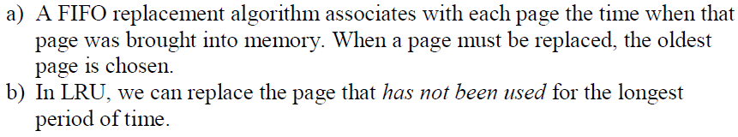
CESN3103-Virtual Memory

Slide 23
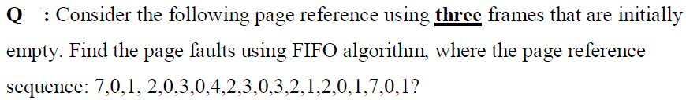
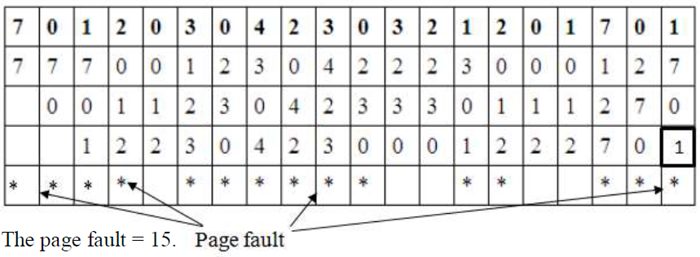
3 frames vs 20 pages
CESN3103-Virtual Memory

Slide 24

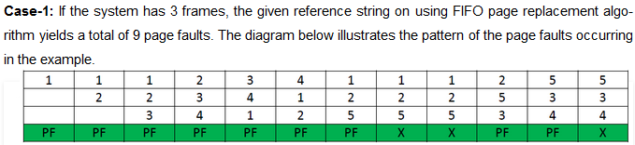
Belady’s Anomaly
Bélády’s anomaly is the name given to the phenomenon where increasing the number of page frames results in an increase in the number of page faults for a given memory access pattern.
CESN3103-Virtual Memory

Slide 25
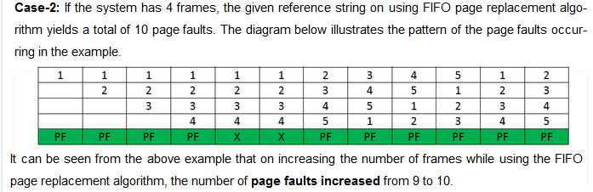
Belady’s Anomaly
CESN3103-Virtual Memory

Slide 26
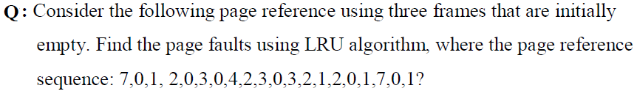
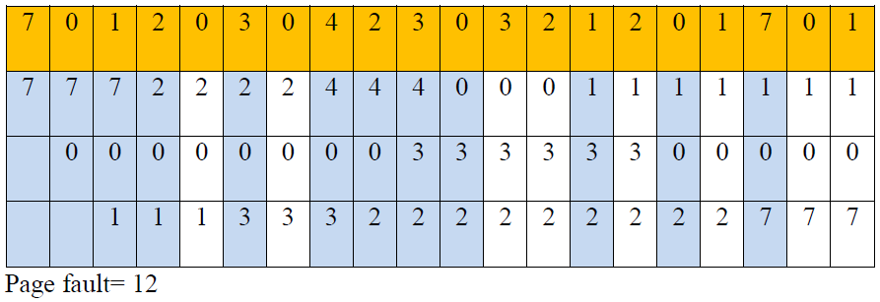
CESN3103-Virtual Memory

Slide 27

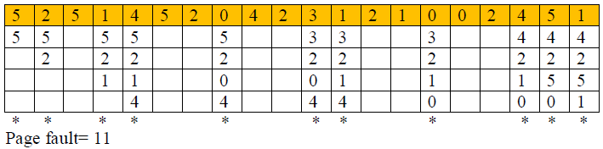

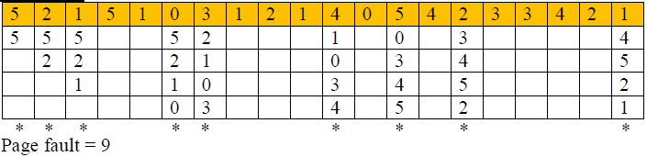
CESN3103-Virtual Memory

Slide 28
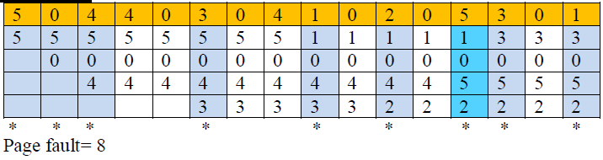
CESN3103-Virtual Memory

Slide 29
Desirable Page Fault Characteristics
Page
Fault
Rate
Desirable operating Zone
Low page fault zone
High page fault zone
No. of page frames allocated to a process →
CESN3103-Virtual Memory

Slide 30
A process that is spending more time paging than executing is said to be thrashing. In other words it means, that the process doesn't have enough frames to hold all the pages for its execution, so it is swapping pages in and out very frequently to keep executing. Sometimes, the pages which will be required in the near future have to be swapped out.
Page Fault Frequency: another approach to preventing thrashing.
Per-process replacement; at any given time, each process is allocated a fixed number of physical page frames.
Monitor the rate at which page faults are occurring for each process.
If the rate gets too high for a process, assume that its memory is overcommitted; increase the size of its memory pool.
If the rate gets too low for a process, assume that its memory pool can be reduced in size.
If the sum of all memory pools don't fit in memory, deactivate some processes.
CESN3103-Virtual Memory

Slide 31
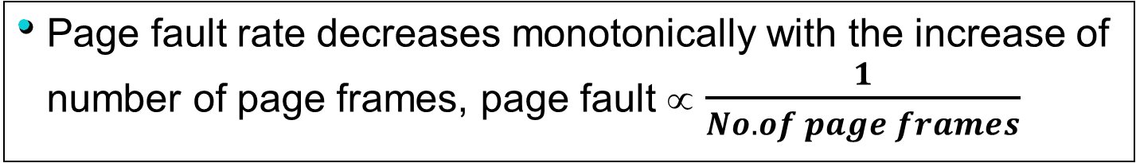
Page Fault & Thrashing
Let’s consider a process (Pi) operating to the left of the desirable operating zone, i.e., in the region of high page fault rates. If all processes in the system operate in high page fault rate zones, the CPU would be mostly busy performing page traffic & process switching, resulting in poor average response time or throughput → resulting in thrashing.
CESN3103-Virtual Memory

Slide 32
Thrashing
If a process does not have “enough” pages, the page-fault rate is very high. This leads to:
  low CPU utilization.
  operating system thinks that it needs to increase the degree of multiprogramming.
  another process added to the system.
Thrashing ≡ a process is busy swapping pages in and out.
Definition: situation in which a process is spending more time paging than executing
CESN3103-Virtual Memory

Slide 33
In demand paging, pages are brought into the physical memory only when the pages are needed. All the pages of a process need not be kept in the main memory at the same time. Only the pages that are used currently need to be kept in the main memory. Suppose a page is brought into the main memory and if there is no free frame in the main memory, a victim page is chosen from the main memory, the victim page is moved out to the backing store and the required page is brought into the main memory. Choosing a victim page for replacement is done by the page replacement algorithms.
The other option is to maintain a pool of free frames always and move in the required page into a frame. The victim page can be moved out later and that frame can be added to the pool of free frames.
Fragmentation: The most severe problem caused by fragmentation is causing a process or system to fail, due to premature resource exhaustion: if a contiguous block must be stored and cannot be stored, failure occurs. Fragmentation causes this to occur even if there is enough of the resource, but not a contiguous amount.
CESN3103-Virtual Memory

Slide 34
Solution to external fragmentation :
1) Compaction : shuffling the fragmented memory into one contiguous location.
2) Virtual memory addressing by using paging and segmentation. External fragmentation can be reduced by compaction or shuffle memory contents to place all free memory together in one large block.
CESN3103-Virtual Memory

Slide 35

Thrashing Diagram
Why does paging work?
Locality model
  Process migrates from one locality to another.
  Localities may overlap.
Why does thrashing occur?
Σ size of locality > total memory size
CESN3103-Virtual Memory

Slide 36
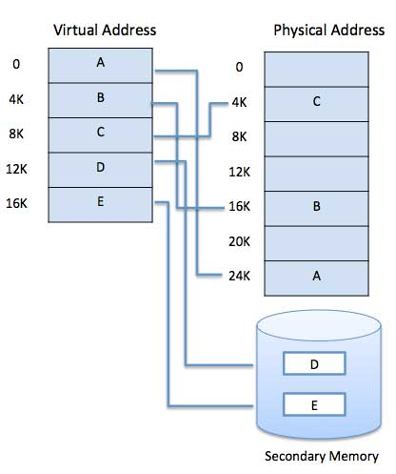
Demand Segmentation
Operating system also uses demand segmentation, which is similar to demand paging.
Operating system to uses demand segmentation where there is insufficient hardware available to implement 'Demand Paging'. The segment table has a valid bit to specify if the segment is already in physical memory or not.
CESN3103-Virtual Memory

Slide 37
Demand Segmentation
Operating system also uses demand segmentation, which is similar to demand paging. Operating system to uses demand segmentation where there is insufficient hardware available to implement ‘Demand Paging’.
The segment table has a valid bit to specify if the segment is already in physical memory or not. If a segment is not in physical memory then segment fault results, which traps to the operating system and brings the needed segment into physical memory, much like a page fault.
Demand segmentation allows for pages that are often referenced with each other to be brought into memory together, this decreases the number of page faults.
Another space server would be to keep some of a segment’s page tables on disk and swap them into memory when needed.
CESN3103-Virtual Memory

Slide 38

Operating System Concepts

